Slide 1
KK-01
Amanda Smith

Slide 2
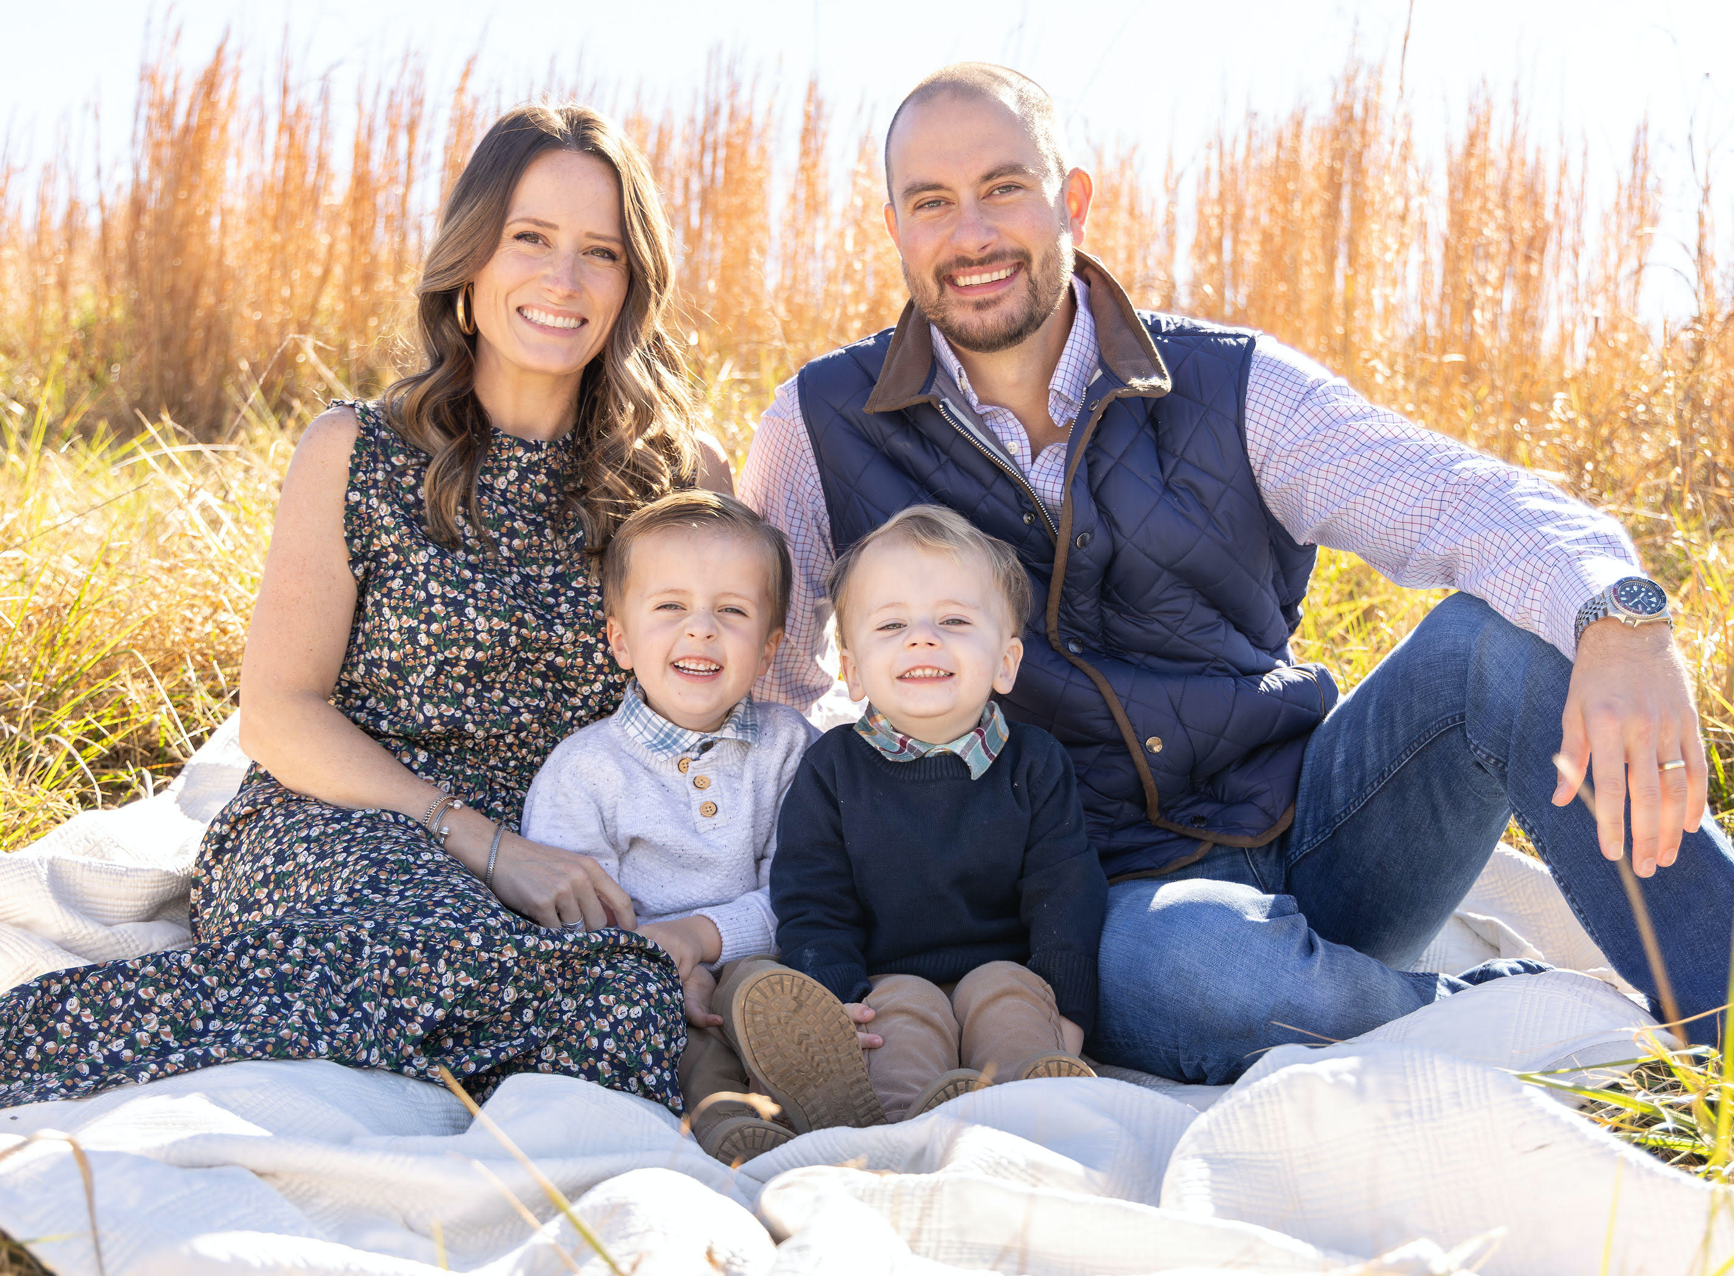
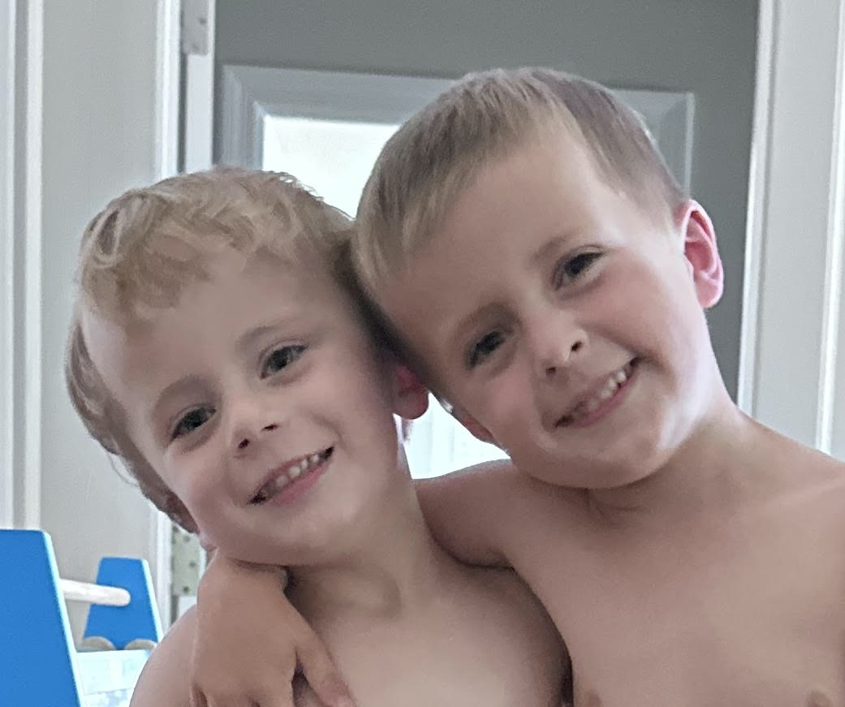
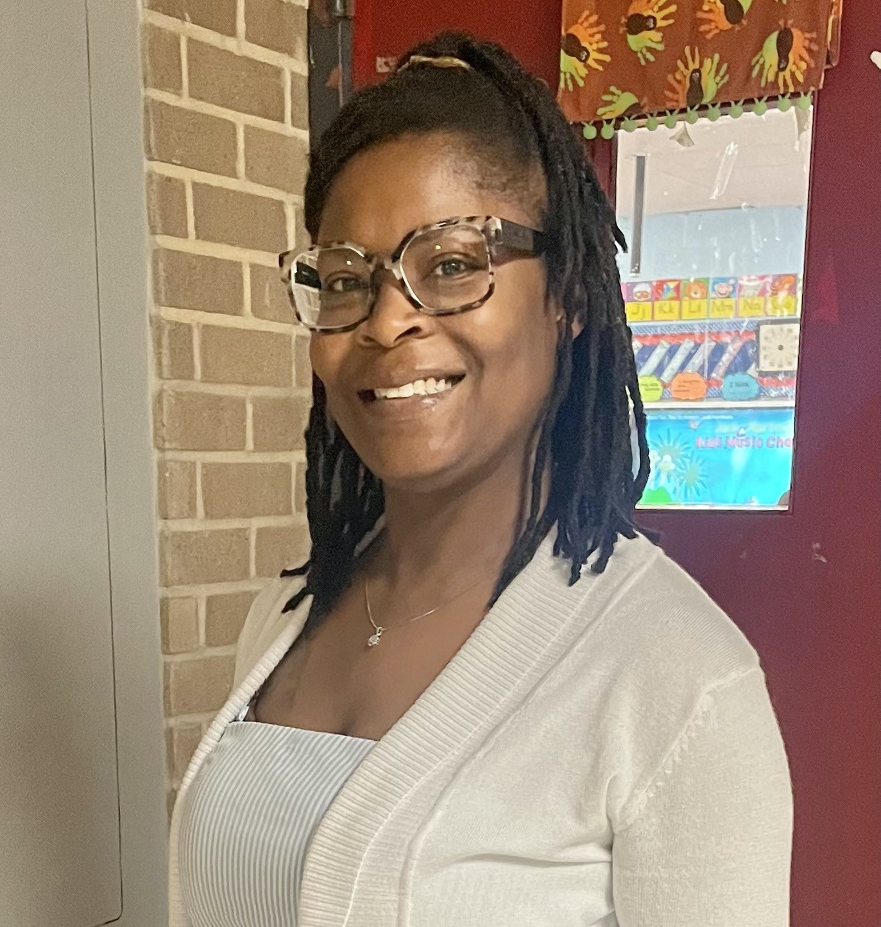
Meet The Teacher
Mrs. Amanda Smith, KK-01
I am from Memphis and am in my 13th year of teaching. I graduated with my Masters Degree in Elementary Education at Ole Miss. I taught Pre-K for 3 years and Kindergarten for 10 years. This will be my 7th year teaching at Richland. My husband and I have two boys- a 3 year old, 5 year old & baby girl on the way. We also have 2 weenie dogs and a cat, which I am sure you will hear about.
Our Assistant is Mrs. Dansberry!
She has been at Richland for 4 years!

Slide 3
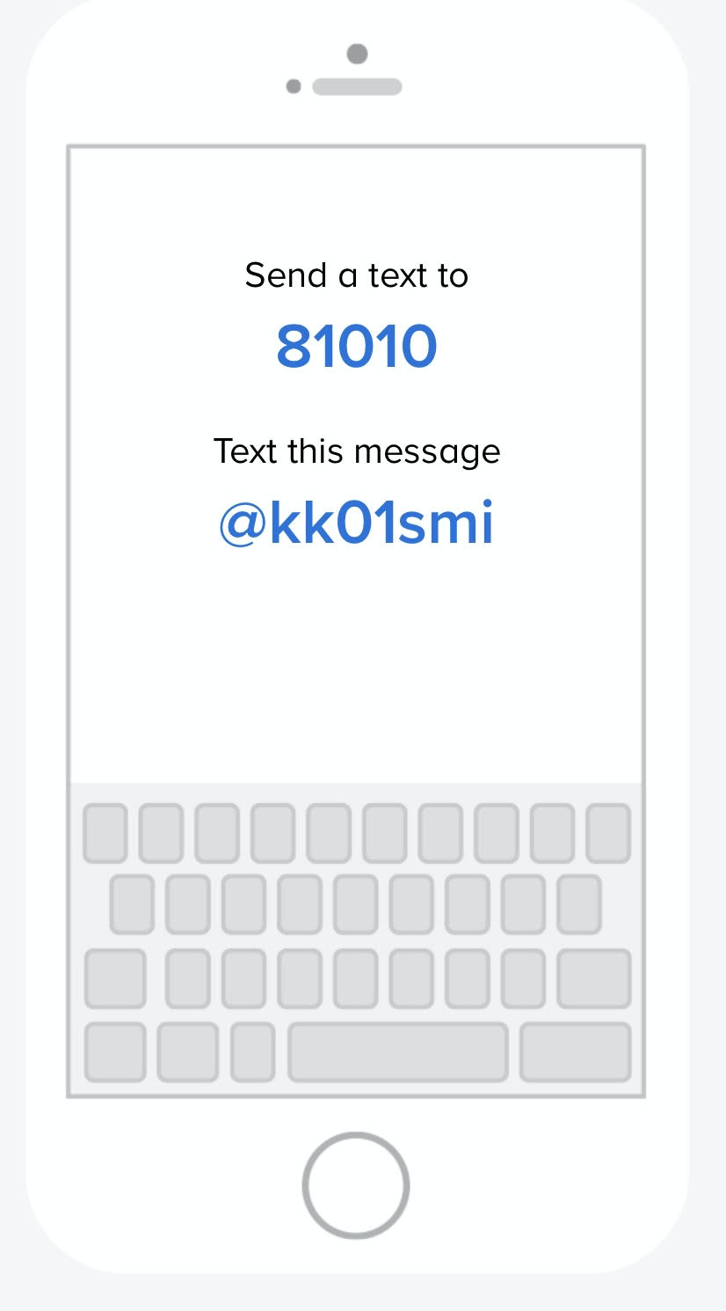
Contact Info
- We will communicate through the REMIND app!
This is where I will post all of my announcements.
- Here is how to join! →
*When you save your name in Remind, please put your child’s name in parenthesis.
Example: Kelly Irine (Hays)
*If you have kids in other grades,
just put all of their names in parenthesis–
example: Kelly Irvine (Margot, Mabry, Hays)

Slide 4
Contact Info
Cell: 901-833-8910
Please only use my cell if you have an emergency, last minute change in transportation, etc. Call the office if I do not respond.
Right Now: Please text me your child’s first and last name. This way I can search text messages for your # in case of emergency.
Email: smitha35@scsk12.org
School Office: 901-416-2148
ICE: always assume I do not have my phone on me

Slide 5
COMMUNICATION/ WEBSITE
Homeroom App:
This is how I will share pictures with you weekly!
It’s kind of like Facebook just for our class. ANYONE can add or share pictures to our group!
Once you join Remind, I can send you the link, OR you can go to this website now to join!
https://gethomeroom.com/i/RWPLLQE6

Slide 6
COMMUNICATION/ WEBSITE
My Website:
https://tn50000520.schoolwires.net/Domain/4174
CHECK THIS WEEKLY. It is updated on Fridays.
Please check my website before asking me!
This is how to save it to your favorites on your phone…
(see next slide)
Conferences:
twice a year (you will pick one),
or informal conference as needed
MAKE SURE TO CHECK THE PTO CALENDAR!!
https://richlandpto.org/calendar

Slide 7
COMMUNICATION/ WEBSITE

Slide 8
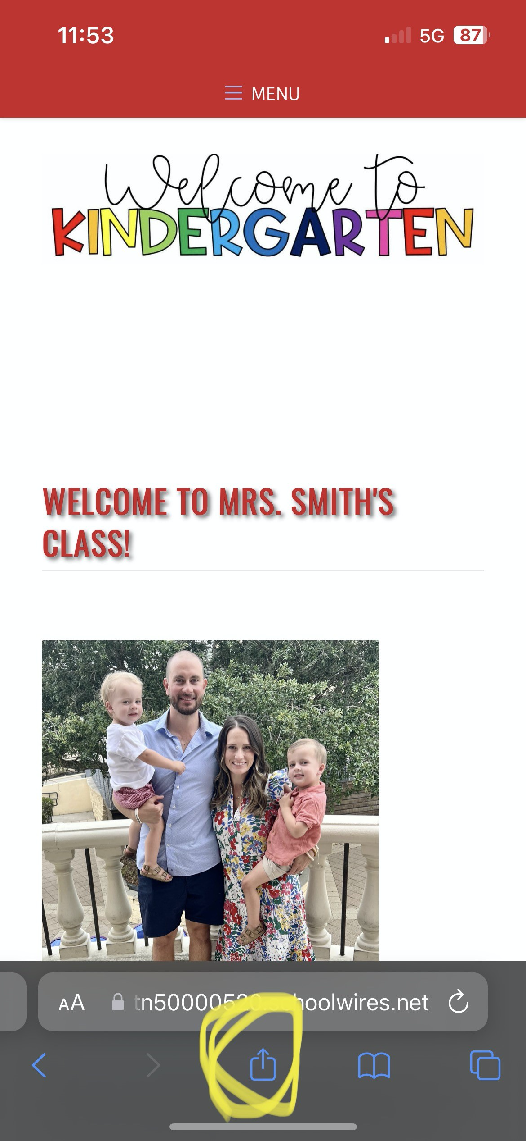
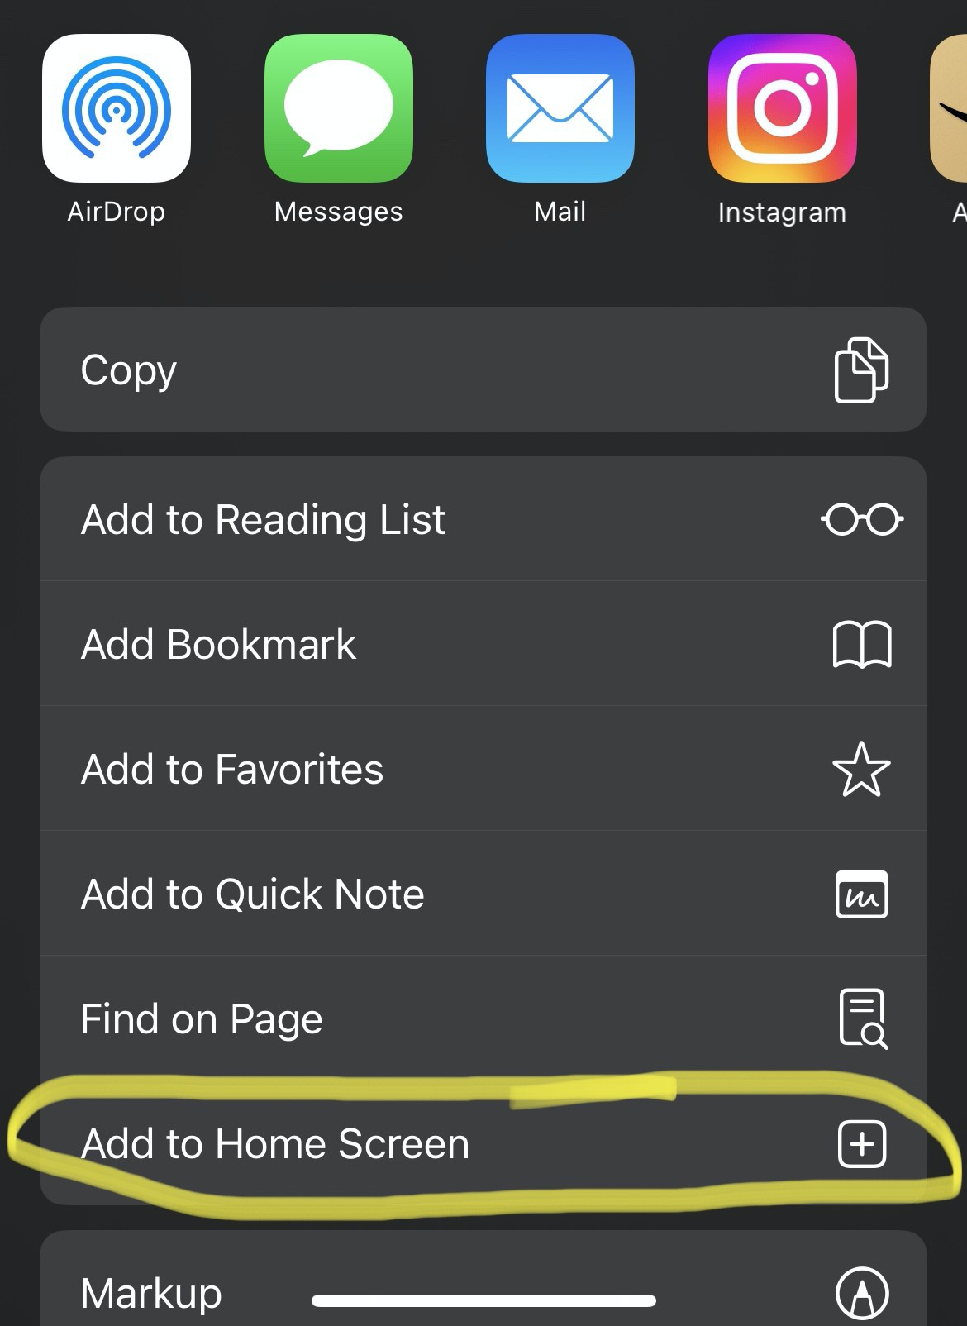
COMMUNICATION/ WEBSITE

Slide 9
Lunch & SNack
Lunch:
You may pack one or get a school lunch.
School lunch is FREE for all students.
If your child has a severe peanut allergy, they will sit at the peanut free table. LET ME KNOW TONIGHT!
STUDENTS will put lunch boxes & water bottles on the shelf outside my door every morning when they come in.
Snack:
You will have 1 snack day/ month. (Please check my website under “Teacher Updates” for your day).
Bring 24 individually wrapped snacks on your day.
NO NUTS.
If you forget to bring snack on your day, bring the next day!
* Their snack day is also their “SHARE DAY.” They can bring 1 small toy, picture or item to share with the class during snack time.

Slide 10
Arrival & Dismissal
* School Hours→ 8:05-3:10
* Students can arrive at school as early as 7:45 to eat breakfast in the cafeteria.
* Students are tardy after 8:20.
* You may NOT check your child out after 2:30.
* MORNING DROP-OFF car line will run in the direction, from Yates to White Station. PLEASE do NOT park in front of the small playground/ Brennan Park in the morning or you will block the carline.

Slide 11
Arrival & Dismissal
Safety:
ALL parents must enter through the front door/ buzz into the office. We cannot let you in the side doors.
We teach the children they CANNOT open an outside door for anyone! (not even the principal)
ALL outside doors are locked at all times. None are propped open.
ALL classroom doors are closed and locked at all times.
DISMISSAL:
We will dismiss from the back door in our classroom.

Slide 12
Arrival & Dismissal
* Regular school attendance is essential. Please make every effort to have your child at school on time each day. (We don’t want them getting a truancy letter or missing their morning journal!)
If your child will be absent from school, please call the school office (416-2148).
Please also text me that morning!
Return with a note for the office OR email a note to NelsonCW@scsk12.org (Ms. Kacky in the office).

Slide 13
Arrival & Dismissal
* FIRST Staggered Day (8/5-8/8):
You may walk your child to the classroom and stay for a few minutes to get them settled in and take pictures ☺
* FIRST DAY with ALL students (8/12):
You may walk your child to the classroom again.
**YOU MAY NOT WALK THEM TO CLASS AFTER AUGUST 12th**
There will be teachers at the front to help them line up and walk to the room. ☺

Slide 14
Backpacks & STAR FOLDERS
* BACKPACKS:
- Backpacks should be large enough to fit→
Star Folder, *Jacket, Change of clothes, ”Share” item
on their day... without causing them frustration!
- NO ROLLERS
*our classroom is COLD in the summer! Pack a light sweater daily!
* Take Home Folders:
- These will go home everyday.
- Please take time to check for important information from school. Check the pocket inside their folder for notes from school/ finished class work.
- Remove work daily!

Slide 15
BRING EVERYDAY!
Change of UNIFORM clothes in backpack at all times (including socks) Change them with the seasons!
Backpack
TAKE HOME FOLDER- “STAR folder”
- Water Bottle WITH LID
* NOT disposable ones
* Must be LABELED
* MUST have WATER in it (no juice)!
*Devices and headphones will be kept at school!

Slide 16
Curriculum
ELA: Wonders
(I also supplement Jan Richardson’s Next Step to Guided Reading during reading groups, as well as, Science of Reading)
MATH: enVision
SCIENCE/ SS: Inspire Science & embedded into curriculum

Slide 17
Journal
Journal writing occurs M-TH, first thing in the morning!
Through exposure to phonics skills and a variety of reading experiences, journal entries move from pictures and temporary spelling/ labeling→ toward more conventional writing.
*It is a great idea to have a journal for your child to have fun writing at home!
*Encourage ALL forms of writing!
*DO NOT tell them how to spell something!
(They may use inventive spelling: techr, tabl, frind)

Slide 18
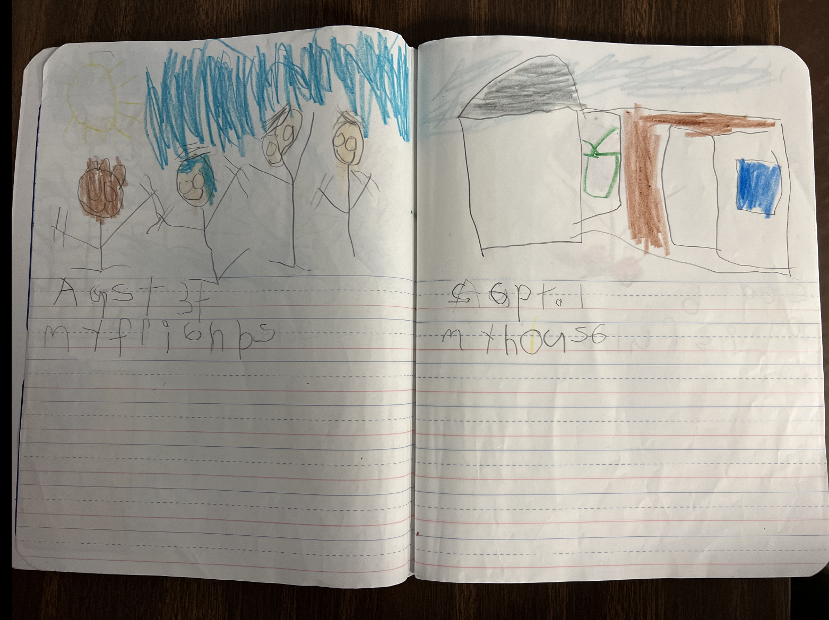
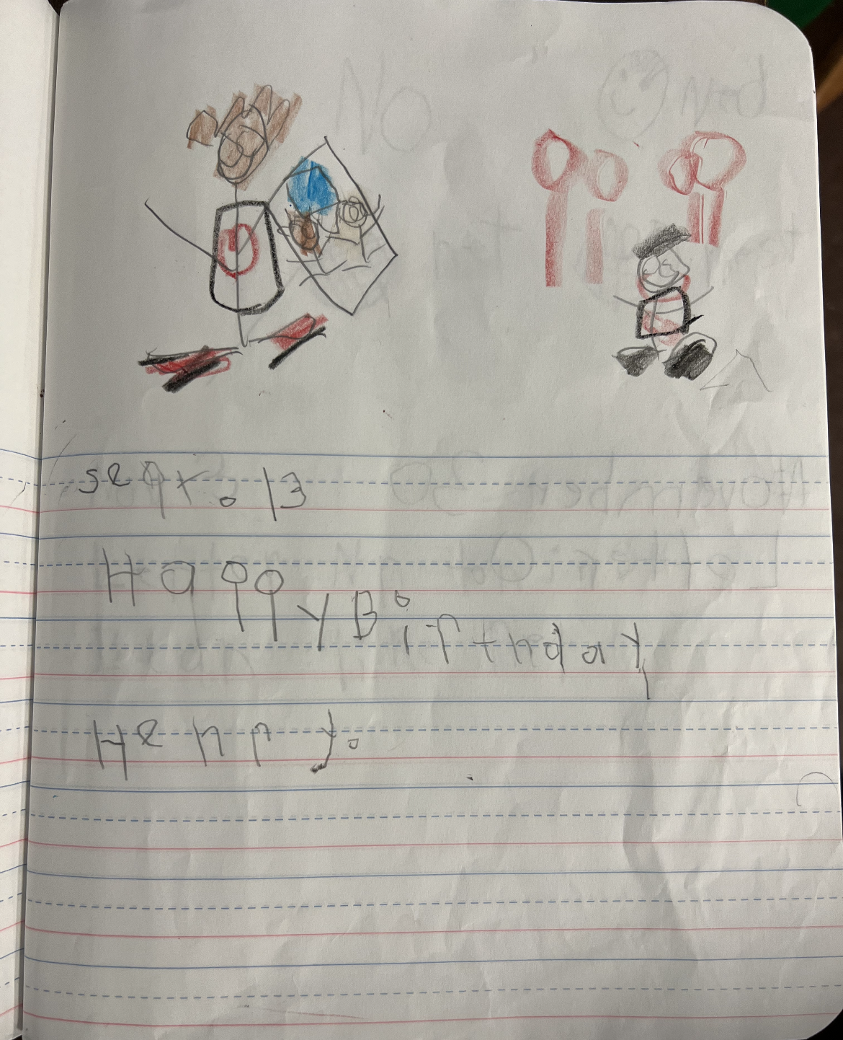
Beginning of
Kindergarten
Journal

Slide 19
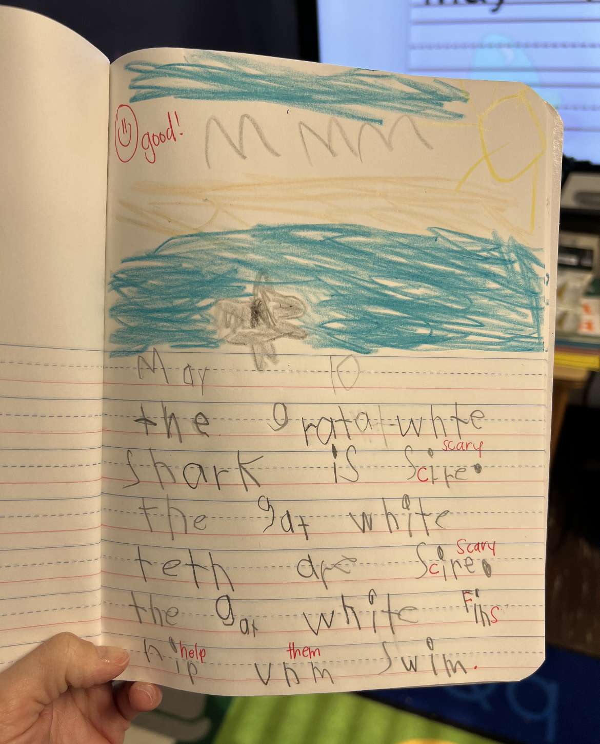
End of
Kindergarten
Journal

Slide 20
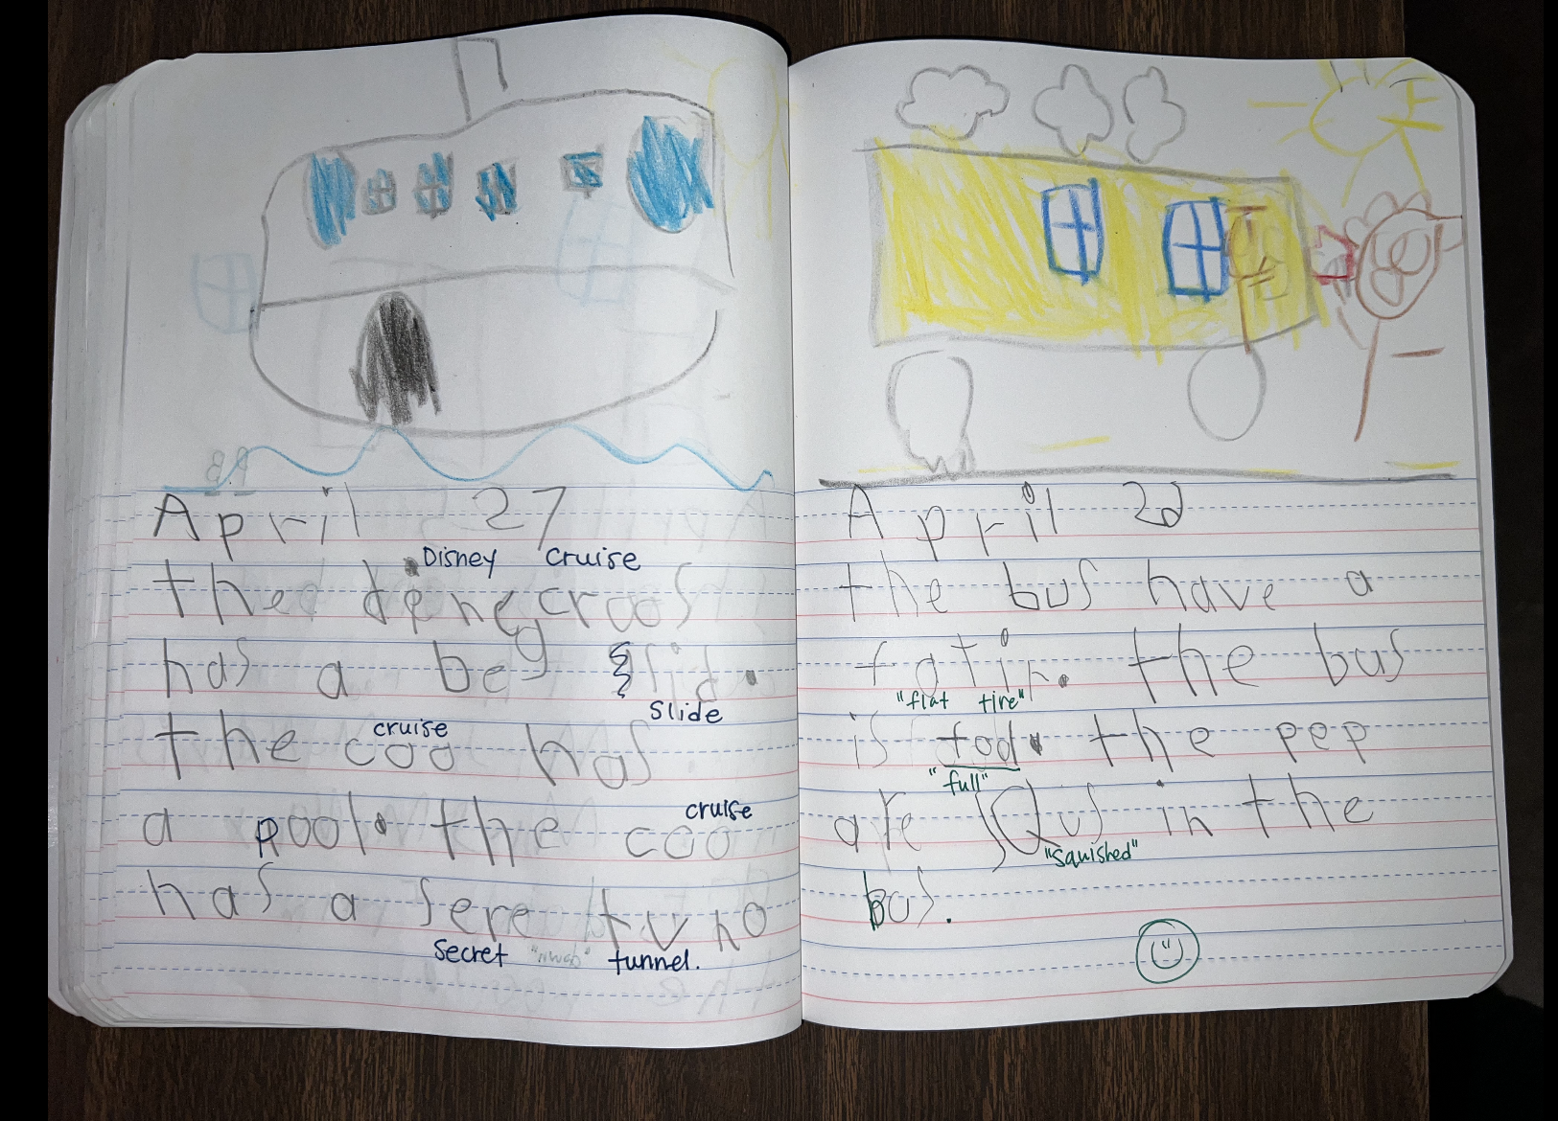
Journal

Slide 21
Homework
Kindergarten homework calendar is OPTIONAL, but highly encouraged to prepare them for 1st grade.
READ NIGHTLY
PRACTICE SIGHT WORDS (sight word ring)

Slide 22
GRADES
* Report Cards:
- Standards-Based Grading (M or X)
(I will send home a list of the ELA standards
for each Q in their STAR folders… please look at these each quarter to make sure they are on track)
* Benchmark Assessments (i-ready, mastery connect)
* Informal Assessments
* Daily Calendar (Conduct)

Slide 23
Celebrations/ Class Parties
- Birthdays:
- Titles for Tomorrow, Special Snack Day,
Birthday Lunch) *No cupcakes/balloons*
2 Field Trips
Zoo in the Fall and Botanic or Farm in the Spring
- Thanksgiving Feast*
- Winter Party
End of Year
NEED ROOM PARENT TO HELP ORGANIZE PARTIES & EVENTS!

Slide 24
FIELD TRIPS!
We are a CASHLESS SCHOOL
Go online to create your account here:
https://mscsk12.schoolcashonline.com/
IT ONLY TAKES 2 MINUTES!
If you run into any issues, go to the parent help desk here:
https://helpdesk.supportschoolcashonline.com/en/support/home?email=&board_name=Memphis-Shelby%20County%20Schools&mw=0&mp=0

Slide 25
Uniform
*NO BLUE shirts
*NO BLUE polo dresses
* Shoes:
tennis shoes, sandals with back strap
*NO Crocs
*NO light up shoes

Slide 26
Other Important Info
Label personal items
lunch box, jackets, water bottle
Independence
tying shoes, zipping, opening milk, etc.
Please wear “no tie” shoes if they cannot tie yet!
Rest
we did away with nap 2 years ago, so please make sure your child gets plenty of sleep nightly. Bedtime should be BEFORE 8 for optimal rest throughout the week

Slide 27
Supplies
*
Any questions about the supplies?
Please do not get Bluetooth headphones, they need a cord.

Slide 28
8:05 Arrival
8:15-10:45 ELA
(Morning Meeting, Calendar Math, whole group ELA & reading groups)
10:50-11:20 LUNCH
11:25-11:55 RECESS *no parents*
12:00-1:00 MATH
1:00-2:00 ENCORE
2:05-3:00 BOOST/SNACK/SHARE
3:10 Dismissal (outside back door)
Schedule
ENCORE: coming soon
Spanish, Library, Art, Music, PE
Mon-
Tues- *NO ENCORE*
Wed-
Th-
Fri-

Slide 29
DON’T FORGET!
POPSICLES AT THE PARK, August 10th @ 9 - 10
OUR CLASS WEARS PINK!
BEFORE YOU LEAVE, Make sure you…
signed in w/ your name, email and phone #
filled out student papers & returned
signed up for a staggered day
make sure the office has everything for registration → (3 people come see me)
If you haven’t brought supplies, please make sure you do on their staggered day.
Take an item from the giving tree before you leave ☺

